Slide 1

Webinar Stats
(or should the project have a better name?)

Slide 2







Slide 3
Questions
What would be useful statistics to calculate from the data?
What would be useful chart presentations of the data?
What other functionality would be helpful?
Does anyone know how to make fancy dashboard style blocks containing data in shiny, but without shinydashboard, or maybe it has to be re-written and use shinydashboard?
Does anyone want to help with the project? (otherwise I might get bored and never finish it!)

Slide 4
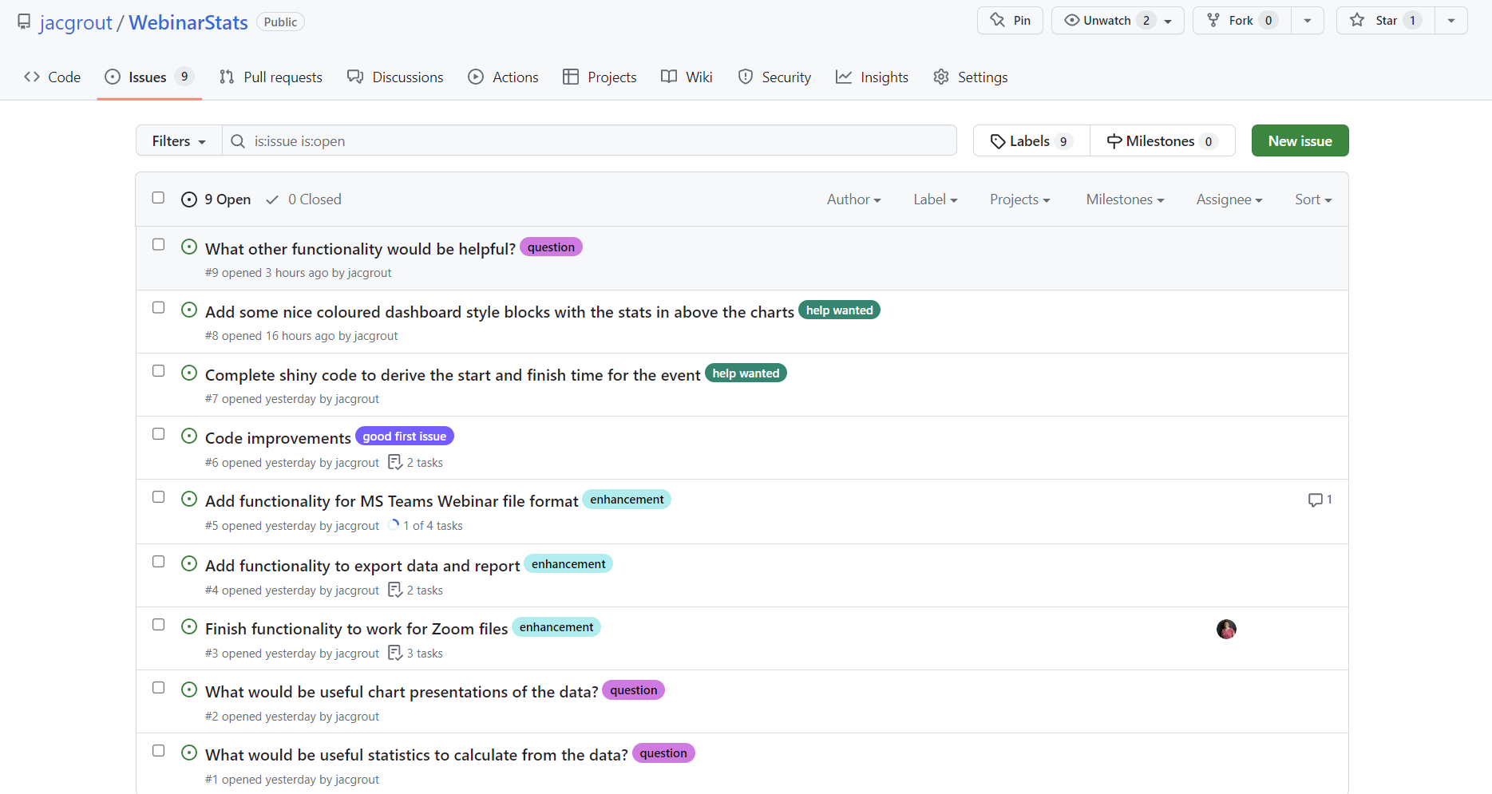
Coffee and coding …….
It’s public on my GitHub account
https://github.com/jacgrout/WebinarStats
It makes a nice project to practice using and collaborating on GitHub
It’s a “would be nice” so no time pressure
It’s not for a client project so its “low stakes”
Small quick tasks to contribute
It demonstrates that a project is not just about “the code”

